Slide 1
What is Role ?
A role is some kind of privilege that you can assign to the user allowing them to perform certain type actions in the application.

Slide 2
Types of Roles
Job Role
Duty Role
Privilege Role
Abstract Role

Slide 3
Job Role
These are also known as Enterprise roles. These roles get mapped to one or more duty roles, because a person that takes a job in a company, then they are meant to perform several duties.
For example, a HR Recruiter Job will have a duty to scan resumes submitted and place an offer to the individual. The name of this role has the suffix _JOB. Some examples are Account Payables Manager Job, General Ledger Accounting Manager Job etc. Job roles are also referred to as external roles.

Slide 4
Duty Role
These are also known as Application Roles, and duties are performed by the individuals.
Examples are Invoice Creation Duty, Invoice Approval Duty, GL Journal Entry Duty, GL Journal Approval Duty, GL Journal Posting Duty etc.
It is like saying to a new staff that you can perform xyz duties within your job or it is your duty to perform x y z things in your organization. The name of this role has the suffix _DUTY.

Slide 5
Abstract Role
These are also known as Enterprise roles.
These roles are associated with a user irrespective of the Job they perform within an enterprise. Therefore abstract roles are at a higher level spanning various jobs, and hence their name abstract.
Abstract roles represent a worker’s role in the enterprise, independently of the job that the worker is hired to do. There are three seeded abstract roles delivered with Oracle Fusion HCM. These are the Employee, Line Manager, and Contingent Worker roles. Abstract roles are assigned to user automatically when some event occurs like Hire an employee, Terminate an employee or Promote an employee.

Slide 6
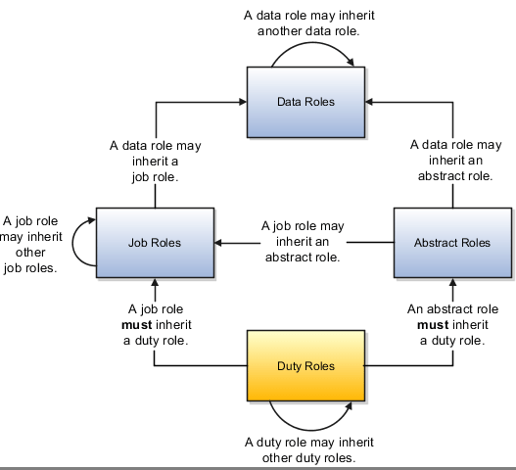

Slide 7
Fusion Roles
Fusion
EBS
Data Role
Job Roles
Duty Role
Privilege Role
Data restriction
Responsibility
Menu, Sub Menu
Form Function

Slide 8
function security and data security
Function security is a statement of what actions you can perform in which user interface pages.
Data security is a statement of what action can be taken against which data.
Function security controls access to user interfaces and actions needed to perform the tasks of a job. For example, an accounts payable manager can view invoices. The Accounts Payable Manager role provisioned to the accounts payable manager authorizes access the functions required to view invoices.
Data security controls access to data. In this example, the accounts payable manager for the North American Commercial Operation can view invoices in the North American Business Unit.

Slide 9
Requirement :
There is a Security in chief (lets say Mr. Security) responsible for taking care of all security measurements in your organization. He needs to be given authority to terminate any employee caught violating security guidelines. In oracle terminology he needs to be given a new role to be able to terminate any employee within your organization.

Slide 10
Now the function to terminate employee is already available with few seeded roles like Manager and HR Specialist but you can not assign them to Mr. Security as using the seeded role “Manager” he would be able to terminate only people falling under the manager hierarchy. You cannot also assign another seeded role “Hr Specialist” to Mr Security as it comes with many other powerful things along with Termination.
So the only option is to create a new custom role only for terminating employees and assign it to Mr Security. In the next steps we will see how can this be done.

Slide 11
Thank You.
www.techleadsit.com
8125 32 32 32

